Slide 1
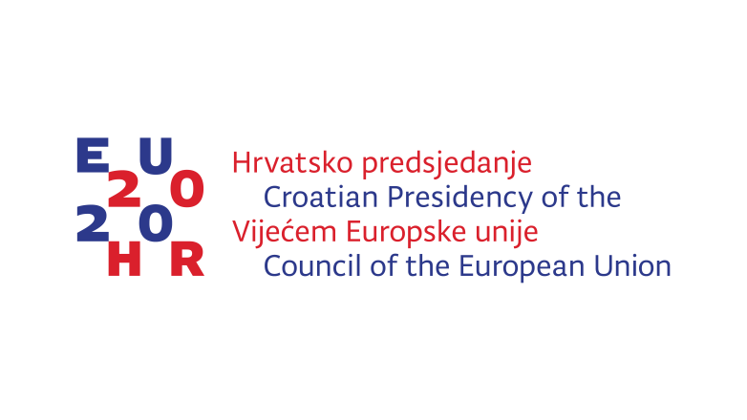
Croatian Presidency of the Council of the European Union
A strong Europe
in a world of challenges

Slide 2
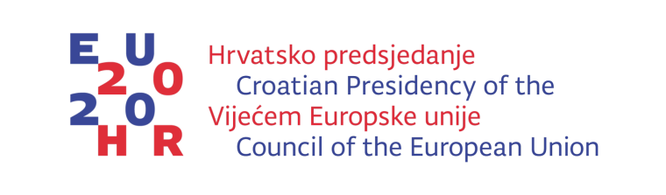
Four pillars of presidency
A EUROPE THAT DEVELOPS
A EUROPE THAT CONNECTS
A EUROPE THAT PROTECTS
AN INFLUENTIAL EUROPE

Slide 3
A EUROPE THAT DEVELOPS
Activities within the objective „A more satisfied and vital society”:
Implementing the European Pillar of Social Rights, including work-life balance
Establishing measures to stop negative demographic trends
Promoting equality between women and men, along with empowering women in society and on the labour market
Creating better opportunities for young people, especially in rural areas
Promoting lifelong health care

Slide 4
EPSCO COUNCIL PRIORITES
demographic challenges,wellbeing at work, sustainable health and
Equality between women and men and women’s empowerment in the labour market
Because gender equality and economic independence of women are crucial for sustainable economic growth
The goal is to decrease the employment gap between women and men by addresing barriers to the full participation of women in the labour market

Slide 5
GENDER EQUALITY
2020 EVENTS
EU High Level Conference “Participation of women in the labour market – benefit for the society!” (30 – 31 January)
„International Women's Day Breakfast Event "Strong Women-Strong European Union"- (Council General Secretariat and HR PRES - 8 March)
Ministerial Conference „Demographic Challenges and Opportunities for Growth and Development of the EU” (6-7 April)
Council conclusions on Influence of the long-term care on the work/life balance

Slide 6
EU High Level Conference
30-31 January 2020
Four barriers will be discussed through presentations and panel
discussions:
A) Supply and demand of skills and occupations on the labour market from gender perspective;
B) Gender dimension of non-standard, atypical employment;
C) Availability, quality and affordability of home-based long term care;
D) Harassment and sexual harassment in the world of work.

Slide 7
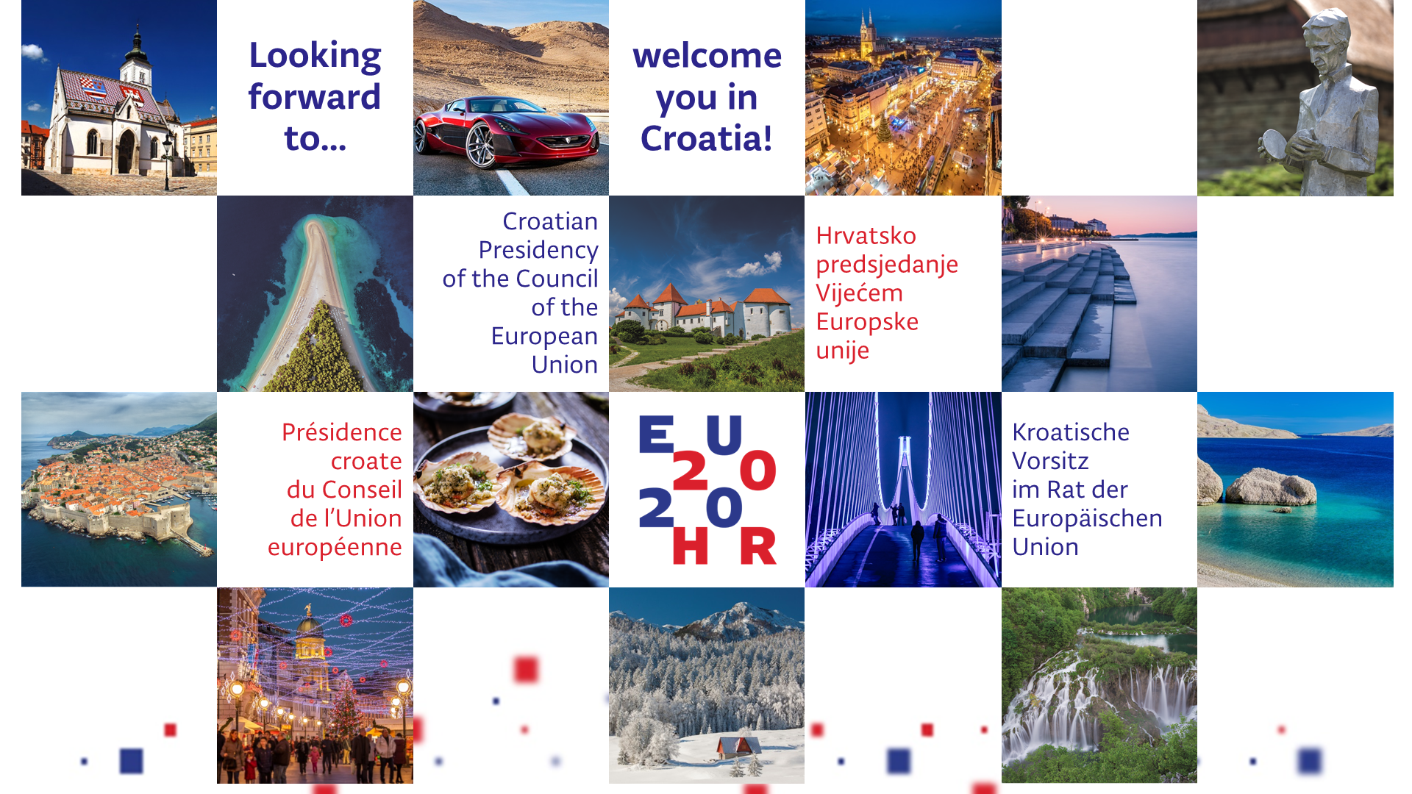
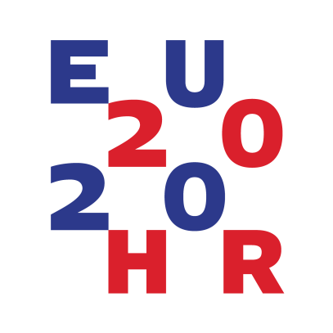

Looking forward to...
welcoming you to Croatia!
Croatian Presidency
of the Council
of the European
Union
Hrvatsko predsjedanje
Vijećem
Europske
unije
Présidence
croate
du Conseil
de l’Union
européenne
Kroatische Vorsitz
im Rat der Europäischen Union

Slide 8
Thank you for your attention!

